Slide 1
Python
Other Data Manipulation
Jeremy Bergmann - Omaha Data Science Academy

Slide 2

Python/Data Science Code Menu - Pandas
Pandas - high-performance, easy-to-use data structures and data analysis tools, including:
DataFrame object for data manipulation
Tools for reading and writing data
Intelligent data alignment and handling of missing data
Flexible reshaping and pivoting of data sets
Slicing, fancy indexing, and subsetting of large data sets
Aggregating or transforming data with “group by” engine
Merging and joining of data set
Time series-functionality
Documentation: http://pandas.pydata.org/pandas-docs/stable/

Slide 3

Python/Data Science Code Menu
Scikit-Learn - “Simple and efficient tools for data mining and data analysis” - Used for DS Projects.
Preprocessing & Data Imputation
Dimensionality Reduction
Classification
Regression
Clustering
Model selection
User Guide: https://scikit-learn.org/stable/user_guide.html
Examples: https://scikit-learn.org/stable/auto_examples/index.html

Slide 4
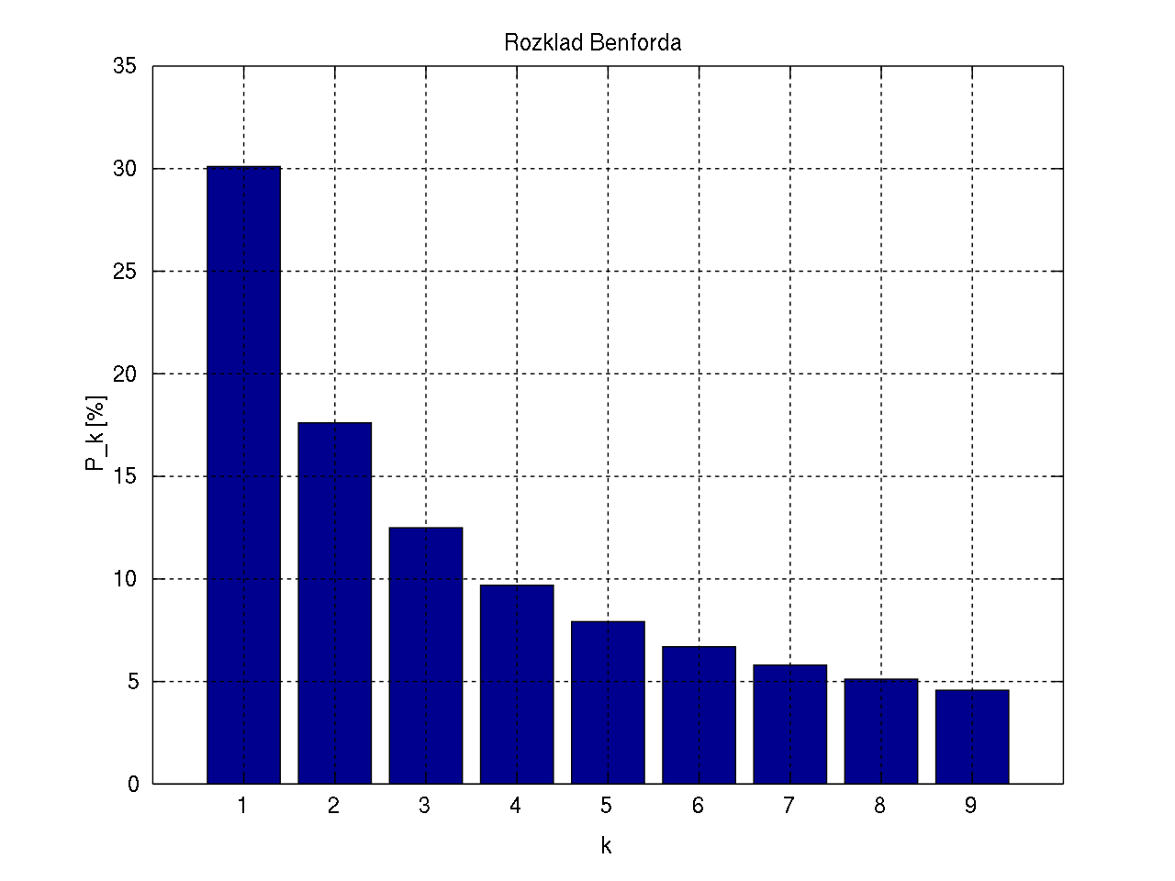
Python/Data Science Code - Benford’s Law
Benford’s Law - In many naturally occurring collections of numbers, the leading significant digit is likely to be small.
Expected in: Transaction data, Numbers that result from combo on #’s (quantity x price)
Not Expected in: Sequential Numbers, Influenced by human thought ($1.99)
Applications: Fraud Detection, Genome size
Class Example: https://github.com/milcent/benford_py.git
The distribution of first digits, according to Benford's law. Each bar represents a digit, and the height of the bar is the percentage of numbers that start with that digit.

